Slide 1
Chapter 1 :Introduction to objects

Slide 2
Introduction to Objects
This chapter will introduce you to the basic concepts of object-oriented programming (OOP)
Give the big picture of object-oriented programming

Slide 3
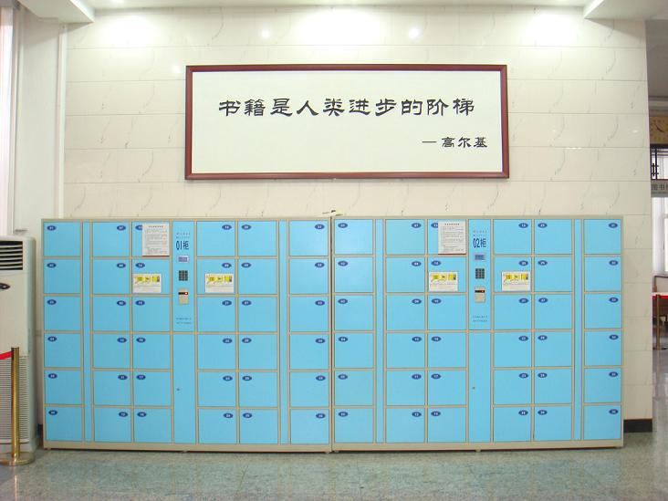
面向对象与面向过程
Notes:
矩形与人造世界的比喻：以什么为单位来构造物理的和虚拟的世界。
软件开发方法学中的其它构造单位包括：
面向过程
函数式语言
基于规则的语言

Slide 4
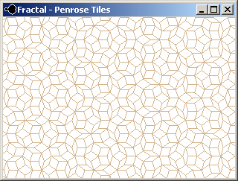
面向对象与面向过程

Slide 5
面向对象与面向过程
基于类型的分解 如果一个系统在演化过程中需要修改时，基本上可以通过增加或者修改类来实现，那么这样的系统就适合于采用面向对象的方式来实现。
基于功能的分解 如果大部分的演化可以通过增加或者修改功能来实现，那么这样的系统就适合于采用面向过程的方法来实现。
Notes:
In functional decomposition, one can modify a function or add a new function without changing the other function definitions.Ho wever, changing or adding a type requires modifying all function definitions.
In type decomposition, one can modify a type (i.e., a class) or add a new type (including by inheritance) without changing the other type definitions.However, changing or adding a function requires modifying all class definitions.
When designing a program, it is good to ask oneself what kind of modification is most important.If the type is relatively simple and there are a large number of operations, then the functional approach is usually clearer.If the type is complex, with a relatively small number of operations, then the type approach can be clearer. There are techniques that combine some of the advantages of both approaches.See, e.g., [232], which explains some of these techniques and shows how to use them to build extensible compilers.

Slide 6
Characteristics of OOP
Abstract
Information Hiding
Inheritance
Polymorphism

Slide 7
The progress of abstraction
What is abstraction？
Abstraction is the process or result of generalization by reducing the information content of a concept or an observable phenomenon, typically to retain only information which is relevant for a particular purpose.
<http://en.wikipedia.org/wiki/Abstraction>

Slide 8
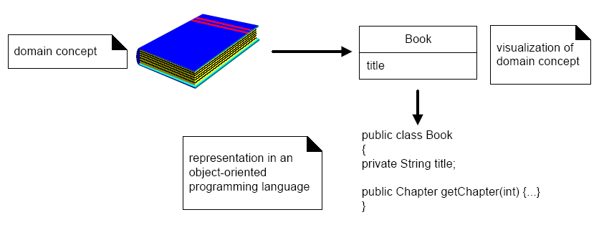
什么是抽象

Slide 9
The progress of abstraction
All programming languages provide abstractions.
Program as a model of real world
It can be argued that the complexity of the problems you’re able to solve is directly related to the kind and quality of abstraction.
程序设计语言的演化过程是抽象层次不断提高的过程。
Notes:
程序通常是现实的一个模型：一个窗口，一间房间。
程序设计语言抽象层次提高的过程就是一个越来越便于描述处理对象的过程：从汇编语言，到面向过程语言，到现在的面向对象的程序设计语言，以至于未来的领域特定的程序设计语言。

Slide 10
The progress of abstraction
The following characteristics represent a pure approach to object-oriented programming:
Everything is an object
A program is a bunch of objects telling each other what to do by sending messages
Each object has its own memory made up of other objects.
Every object has a type .
All objects of a particular type can receive the same messages .
纯的面向对象的程序设计语言能够保证写出面向对象风格的程序吗？
Notes:
万物皆对象：
在Java中Collection<int>符合语法吗？
int a = 0;
a.toString()能通过编译吗？
程序就是一组对象，对象之间通过发送消息互相通知做什么.
a+b如何解释为对象间发送消息的过程？
纯的面向对象的程序设计语言是否能够保证写出真正的面向对象风格的代码？

Slide 11
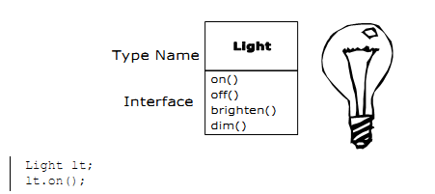
An object has an interface
a class describes a set of objects that have identical characteristics (data elements) and behaviors (functionality)

Slide 12
The hidden implementation
It is helpful to break up the playing field into :
class creators ,those who create new data types
client programmers, the class consumers who use the data types in their applications

Slide 13
The hidden implementation
The goal of the client programmer is to collect a toolbox full of classes to use for rapid application development.
The goal of the class creator is to build a class that exposes only what’s necessary to the client programmer and keeps everything else hidden.

Slide 14

能够热咖啡的CPU
Notes:
早年的DOS操作系统：DOS未公开的秘密

Slide 15

另一种热咖啡的办法

Slide 16
隐藏实现的细节
现实世界中的信息隐藏
电视遥控器
咖啡加热器
程序中的信息隐藏(封装)
提供更加明确的接口(界面)
保护易于变化的部分
通过访问控制来达到隐藏实现细节的目的
抽象与封装
抽象让人能从一个比较高的层次来观察对象，而封装则限制你只能从这个层次来观察对象。

Slide 17
隐藏实现的细节
例：获取一年的某天是否为节假日
class HolidayManager{
public char[365] days;
}
class HolidayManager{
private char[365] days;
public boolean isHoliday(Date date){
……..
}
}
Interface HolidayManager{
public boolean isHoliday(Date date);
}

Slide 18
Reusing the implementation: Composition
Once a class has been created and tested, it should (ideally) represent a useful unit of code.
It turns out that this reusability is not nearly so easy to achieve as many would hope
The simplest way to reuse a class is to place an object of that class inside a new class, this concept is called composition.

Slide 19
Reusing the implementation Composition
Composition comes with a great deal of flexibility.
The member objects of your new class are usually private, making them inaccessible to the client programmers.
The member can be dynamically changed so that the behavior of your program can be changed too.

Slide 20
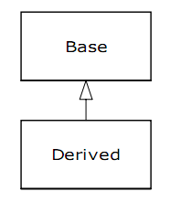
reusing the interface: Inheritance
When you inherit from an existing type, it duplicates the interface of the base class. That is, all the messages you can send to objects of the base class you can also send to objects of the derived class.

Slide 21
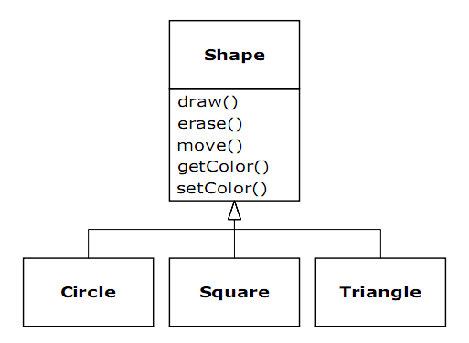
Inheritance ：Simple Inheritance
继承反映了类型之间的关系
简单地继承一个类，而不做其他任何事情，派生出的类于其父类具有相同的行为，这一点并不是特别有意义。

Slide 22
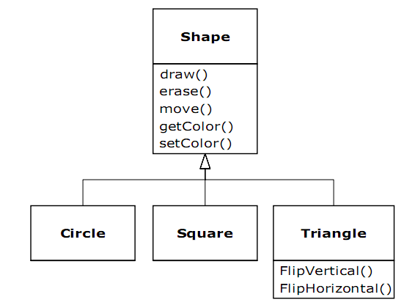
Inheritance ：Change Interface
Change the interface
由于基类没有我们期望这个子类提供的接口，因此需要向子类中增加全新的函数。
在这种情况下，Triangle作为Shape，它的行为没有改变。
Notes:
垂直翻转

Slide 23
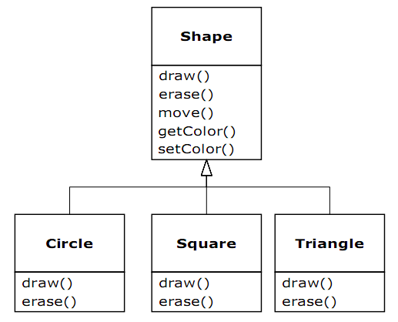
Inheritance ：Overriding
Change the behavior
使用同一个接口函数，但子类与基类将具有不同的行为。

Slide 24
Is-a vs. is-like-a relationships
Is-a
The derived type is exactly the same type as the base class
This can be thought of as pure substitution
Is-like-a
when you must add new interface elements to a derived type, thus extending the interface and creating a new type.
The new type can still be substituted for the base type, but the substitution isn’t perfect because your new functions are not accessible from the base type.

Slide 25
Interchangeable objects with polymorphism
When dealing with type hierarchies, you often want to treat an object not as the specific type that it is but instead as its base type. This allows you to write code that doesn’t depend on specific types.

Slide 26
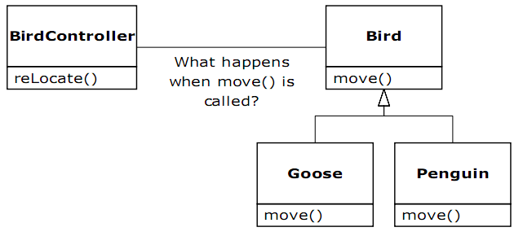
Interchangeable objects with polymorphism
class BirdController{
Collection<Bird> birds;
public void reLocate(){
for(Bird bird : birds){
bird.move();
}
}
}
Notes:
Penguin：企鹅

Slide 27
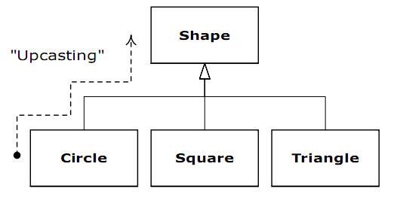
upcasting
We call this process of treating a derived type as though it were its base type upcasting.

Slide 28
What’s happend
函数调用通常被编译成指针跳转到函数的开始位置，这是在编译和连接是就确定下来的。这被称为early binding。
然而OOP的编译器多态采用了late binding的技术，函数调用是在运行时才确定的。

Slide 29
多态：购物行为模拟器
public abstract class Person{
public String getName(){...}
public Date getBirthday(){...}
public abstract Collection shopping();
}
public class Girl extends Person{
public Collection shopping(){...}
}
public class Boy extends Person{
public Collection shopping(){...}
}

Slide 30
多态：购物行为模拟器
继承被滥用很危险。
在可能的情况下，用属性来组合其他类以达到重用的效果。
enum Gender{
male, female
}
public class Person{
public String getName(){...}
public Date getBirthday(){...}
public Gender getGender(){...}
}
Notes:
男/女 学生/教师

Slide 31
多态：购物行为模拟器
然而，就我们的应用而言，由于Girl和Boy在Shopping时的行为有所不同，如果不采用继承的方法：
public class Person{
public Gender getGender(){...}
public Collection shopping(){
if(getGender()==Gender.male){...}
else{...}
}
}
程序中分支过多，会影响程序的灵活性

Slide 32
多态：购物行为模拟器
Shopping模拟器的实现：
public class ShoppingSimulator{
public Collection simulate(Collection<Person> persons){
for(Person person : persons){
person.shopping();
......
}
}
}

Slide 33
多态：购物行为模拟器
假如狗也可以购物
public class Dog extends Person{
public void shopping(){...}
}
尽管能够临时解决问题，但类型层次怪异，需要重新设计，但如何修改？

Slide 34
多态：购物行为模拟器
较好的解决方案：引入接口
public interface IShoppinger{
Collection shopping();
}
public class Person{
public String getName(){...}
public Date getBirthday(){...}
public Gender getGender(){...}
}

Slide 35
多态：购物行为模拟器
较好的解决方案：引入接口(2)
public class Girl extends Person implements IShoppinger{
public Gender getGender(){return Gender.femal;}
public Collection shopping(){...}
}
public class Boy extends Person implements IShoppinger{
public Gender getGender(){return Gender.male;}
public Collection shopping(){...}
}
public class Dog implements IShoppinger{
public void wangwang(){...}
public Collection shopping(){...}
}

Slide 36
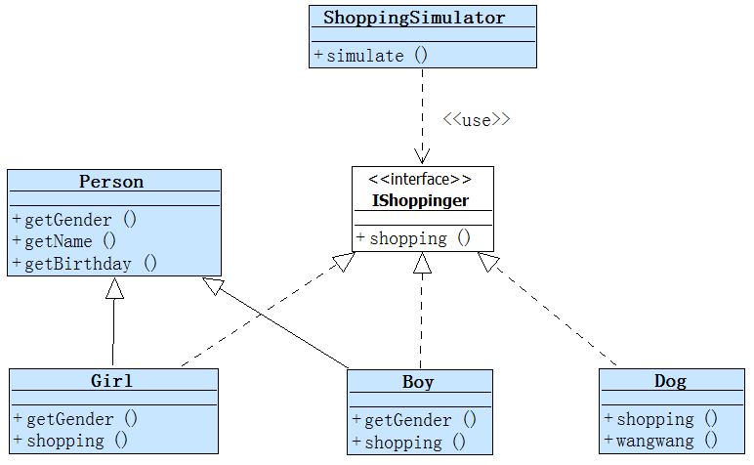
多态：购物行为模拟器

Slide 37
多态：购物行为模拟器
较好的解决方案：引入接口(3)
public class ShoppingSimulator{
public Collection simulate(Collection<IShoppinger> shoppingers{
for(Collection<IShoppinger> shoppinger: shoppingers{
shoppinger:.shopping();
......
}
}
}
什么被重用了？
Notes:
重构的原则

Slide 38
Creating and destroying objects
对象数据存放在何处？
如何控制对象的生命周期？
堆和栈的区别

Slide 39
异常处理
在异常处理发明前，用if/else和返回值来处理异常
异常处理的代码量要多于正常的代码。
正常处理逻辑和异常处理逻辑混在一起。
函数使用返回值来标识错误状态。
使用异常处理后
能够简洁漂亮地处理异常。
正常处理逻辑和异常处理逻辑混分离。

Slide 40
未用异常处理
int printFile (char* fileName)
{
char c[10]；
int result = 0;
FILE *file;
file = fopen(fileName, "r");
if(file==NULL) {
result = 1;
}else {
n = fread(c, 1, 10, file);
if( n!=-1){
c[n] = '\0';
printf(c);
}else{
result = 1;
}
fclose(file);
}
return result;
}
Notes:
在所有情况下，打开的文件都关闭了吗？
所有的错误都预料到了吗？

Slide 41
使用异常处理
public void printFile (String fileName) throws IOException {
char[] c = new char[10];
FileReader reader = null;
try {
reader = new FileReader(fileName);
reader.read(c, 1, 10);
System.out.println(c);
} finally {
if (reader != null) reader.close();
}
}

Slide 42
异常处理：下面代码有什么问题？
public void printFile (String fileName) {
char[] c = new char[10];
FileReader reader = null;
try {
reader = new FileReader(fileName);
reader.read(c, 1, 10);
System.out.println(c);
} catch(IOException e){
}finally {
if (reader != null) reader.close();
}
}

Slide 43
C++的优点
一个较好的C和较快的Java
延续式的学习过程
效率
系统更容易表达和理解
有成熟的类库
可以利用模板实现源代码的重用
支持异常处理

